Slide 1
Calculation policy
Nursery

Slide 2

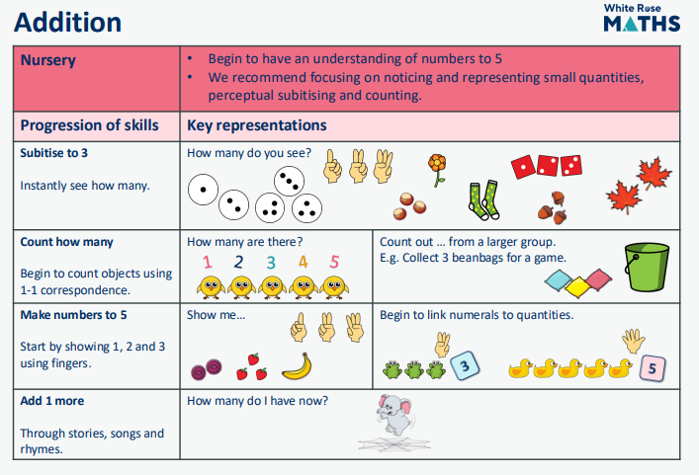

Slide 3


