Slide 1

EAL support by stage

Slide 2
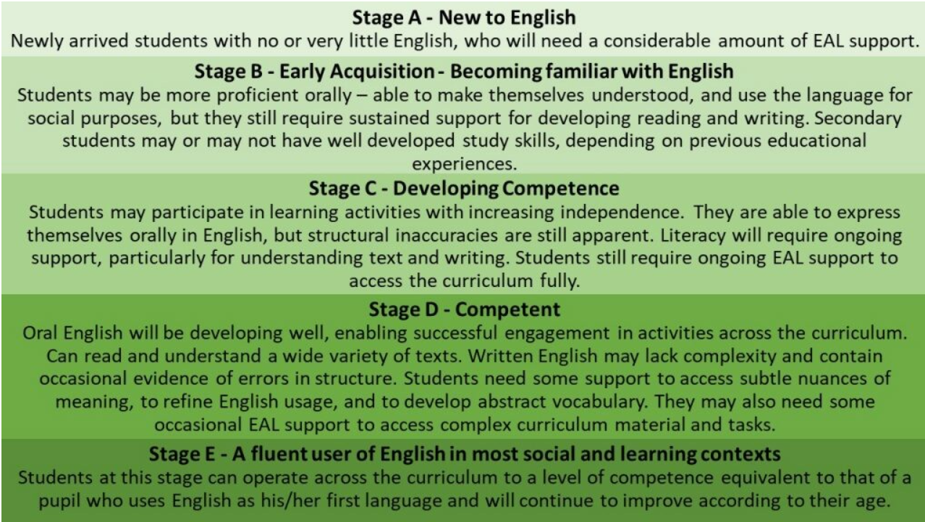

Slide 3
Transition documents completed.
QFT with access to iPad/Chromebook for translation where needed.
Sat next to buddy who supports in and around school (preferably speaks their first language).
Access to visuals
BELLS assessment tool completed and targets worked towards.
Targeted intervention with LSA, EAL lead or SEND TA on a daily basis.
  Intervention for language acquisition (Scheme)
  Pre-teaching of vocabulary
  Dual language books
  Areas of ‘Levels of competency’ to be targeted through intervention work
  Targets gained from Bell’s EAL assessment tracker

Slide 4
Transition documents completed.
QFT with access to iPad/Chromebook for translation where needed.
Access to visuals
Pre teaching of vocabulary using widget (with dual language)
Word mats for reading and writing
Targeted intervention with LSA, EAL lead or SEND TA on a daily basis.
  Intervention for language acquisition (Scheme)
  Areas of ‘Levels of competency’ to be targeted through intervention work
  Targets gained from Bell’s EAL assessment tracker

Slide 5
Transition documents completed.
QFT with access to iPad/Chromebook for translation where needed.
Access to visuals
Pre teaching of vocabulary using widget (with dual language)
Colourful semantics intervention
Word mats for reading and writing
Targeted intervention with LSA, EAL lead or SEND TA on a regular basis
  Areas of ‘Levels of competency’ to be targeted through intervention work
  Precision teaching for reading and spelling
  Targets gained from Bell’s EAL assessment tracker

Slide 6
Transition documents completed.
QFT with access to visuals
Pre teaching of vocabulary using widget
Colourful semantics intervention
Word mats for reading and writing
Targeted intervention with LSA, EAL lead or SEND TA on a regular basis.
  Areas of ‘Levels of competency’ to be targeted through intervention work
  Precision teaching for reading and spelling

Slide 7
Transition documents completed.
QFT with access to visuals
Pre teaching of vocabulary
Grammar as part of QFT

