Slide 1
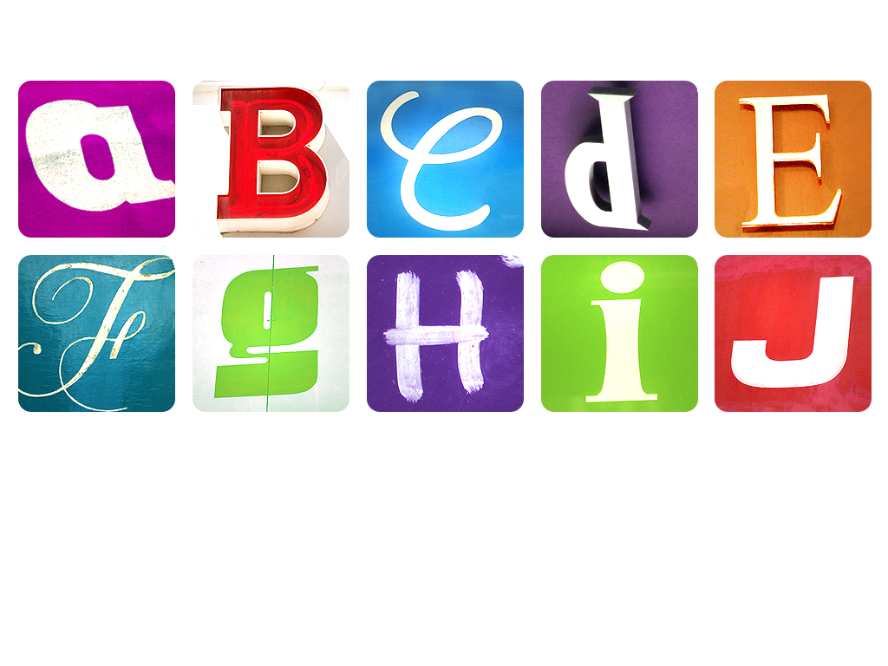

Spelling Rules

Slide 2
Choose your Focus
ai/ay
ss/ce
ou/ow
oi/oy
v/ve
q+u
j/ge
Short o after w
x/s/c
or before l
ur after w
Short o after qu

Slide 3
ai/ay
Can be spelt as ai, a or a_e
Next
Spelling examples
main
bacon
wake
Next
ay is used at the end of a word or before a suffix
stay
played

Slide 4
oi/oy
Mostly spelt as oi
Next
Spelling examples
boil
spoil
noise
Next
oy is used at the end of a word or before a suffix
boy
annoying

Slide 5
j/ge
Words never end with a j. Use ge or dge instead
Next
Spelling examples
cage
stage
huge
badge
edge
judge

Slide 6
or before l
When an or sound comes before the letter l it is mostly spelt a.
Next
Spelling examples
ball
walk
small
chalk
almost

Slide 7
ss/ce
Mostly use ss after a short vowel sound
Next
Spelling examples
miss
toss
fuss
Next
Exceptions to this rule include bus, is, yes, was, his, as and a few more
Next
ce is used after a long vowel sound or an n
mice
prance

Slide 8
v/ve
Words never end with a v. Use ve instead
Next
Spelling examples
love
alive
cave
save
glove
above

Slide 9
Short o after w
When a short o sound comes after the letter w it is mostly spelt a.
Next
Spelling examples
was
wash
want
watch
wandered

Slide 10
Short o after qu
When a short o sound comes after qu it is mostly spelt a.
Next
Spelling examples
quantity
squash
quarrel

Slide 11
ou/ow
Mostly spelt as ou
Next
Spelling examples
loud
sound
mouse
Next
ow is used at the end of a word or before a vowel
cow
tower
Next
ow is used before an l or an n
owl
brown

Slide 12
q+u
A q is almost always followed by a u: there are very few exceptions
Next
Spelling examples
queen
quote
squid
aqua
quickly

Slide 13
x/s/c
An x is never followed by an s. It is sometimes followed by a soft c.
Next
Spelling examples
next
exit
axes
extra
express
Next
Soft c Spelling examples
excellent
excess

Slide 14
ur after w
When an ur sound comes after the letter w it is mostly spelt or.
Next
Spelling examples
worm
worth
worse
world
worship

